Slide 1

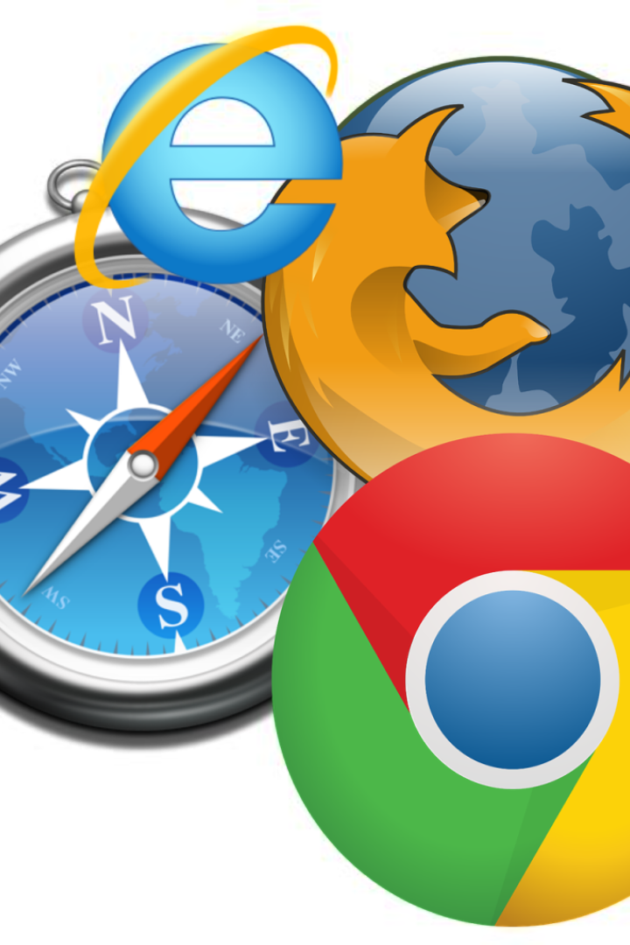
WEB BROWSERS
By Shakib Ali

Slide 2
INTRODUCTION TO WEB BROWSERS
A Web Browser is a software application for retrieving, presenting and traversing information resources on world wide web .
The world wide web (abbreviated as WWW or W3 , commonly known as the Web), is a system of interlinked hypertext documents accessed via the Internet . With a Web browser , one can view web pages that may contain text, images, videos and other multimedia , and navigate between them via hyperlinks.

Slide 3
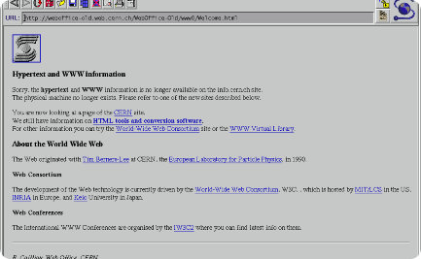
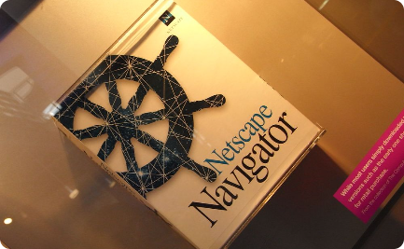

History of Web Browsers
Mosaic: Paving the Way
Mosaic, released in 1993, is considered the first popular web browser to combine a graphical user interface with the ability to display text and images on the same page.
Netscape Navigator Dominance
Netscape Navigator, launched in 1994, quickly became the most used web browser and introduced many features still used today, such as the URL bar and bookmarks.
Internet Explorer Era
Internet Explorer, released in 1995, achieved worldwide dominance due to its pre-installation in Windows OS, shaping the early web experience for many users.

Slide 4
Types of Web Browsers
Graphical Browsers
These are browsers that display images as well as text, rendering web pages visually appealing to users.
Example : - Firefox, Google chrome, Safari, Microsoft Internet Explorer, Opera, Microsoft Edge etc.
Text-Based Browsers
These browsers rely on text alone, offering a fast and lightweight method of browsing the web.
Example : - Lynx, Links, Elinks, W3m etc.
Mobile Browsers
Designed specifically for mobile devices, these browsers optimize web pages for smaller screens and touch interaction.
Example : - Google Chrome, Firefox, Opera Mini, Brave etc.

Slide 5
Popular Web Browsers and Their Features
1. Google Chrome:
Known for its speed, security features, and seamless integration with Google services like Gmail and Drive. it is written in c++, JavaScript and it is developed by Google.
2. Mozilla Firefox
Renowned for its customization options, privacy-focused features, and open-source development. It is written in c, CSS, c++, JavaScript and developed by Mozilla corporation.
3. Apple Safari
Optimized for Apple devices, offering fast performance, energy efficiency, and privacy protection. It is written in c++ and developed by apple.
4. Microsoft Edge
Features include integration with Microsoft services, built-in security, and support for web standards. It is written in C#, C++ and is developed by Microsoft.

Slide 6
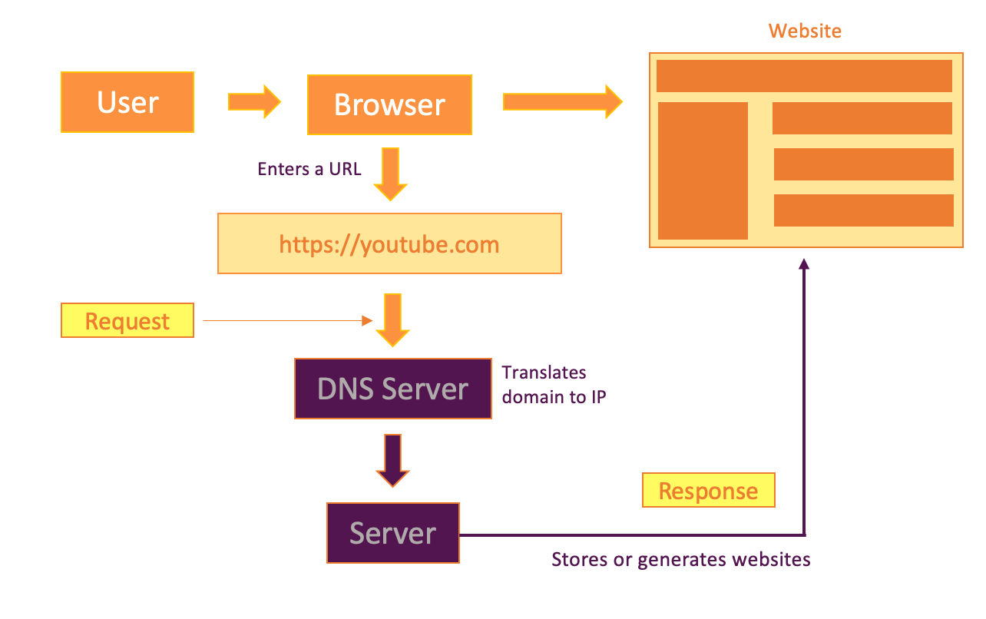



How Web Browsers Work
Requesting a Web Page
When the user enters a web address or clicks on a link, the browser sends a request to the web server for the desired page.
Rendering the Page
The browser interprets the received code and processes the HTML, CSS, and JavaScript to display the page as intended.
User Interaction
Users can interact with the page by clicking on links, filling out forms, and executing various actions based on the web content.

Slide 7
Security and Privacy Concerns with Web Browsers
Data Privacy
Issues related to data collection, tracking, and user privacy have prompted the development of privacy-focused browsers and extensions.
Security Vulnerabilities
Browsers face ongoing threats from malware, phishing attacks, and vulnerabilities that can compromise user data and online safety.
Encryption and HTTPS
Emphasis on secure connections and encryption protocols has become essential for protecting sensitive information transmitted over the web.

Slide 8

Future of Web Browsers
Artificial Intelligence (AI) Integration:
AI-driven personalization for content recommendations.
Enhanced chatbots and virtual assistants for better user interaction.
AR and VR Integration:
Integration of Augmented Reality (AR) and Virtual Reality (VR) for immersive browsing experiences.
3D visualization of web content.
Improved User Interfaces:
More intuitive and customizable user interfaces.
Integration of AI-driven features for better user experience.
Voice and gesture-based controls for hands-free browsing.

Slide 9


